Slide 1

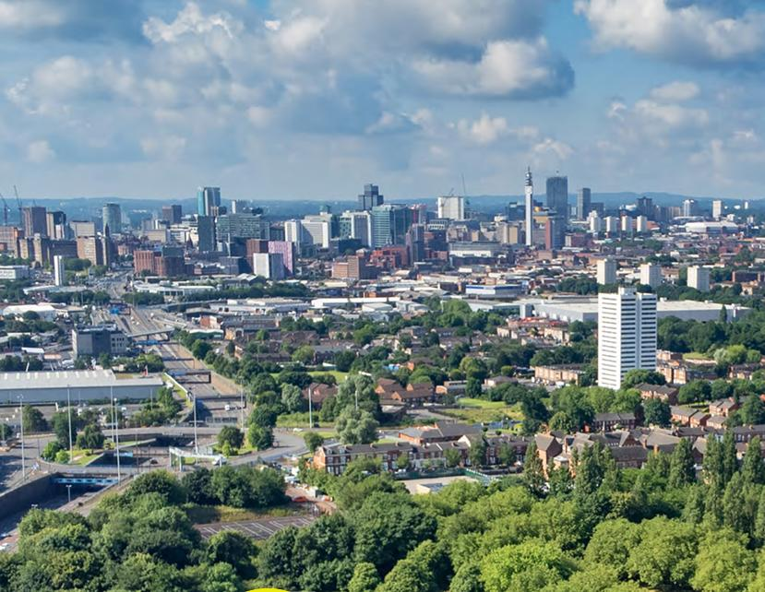
Notes:
Today / Now (if you have added this slide deck to the general ATE slide deck) we are going to have a look at the West Midlands more specifically and what the labour market is like here.
Optional audience question:
Does anyone know what the term ‘labour market’ means or describes? Or know anything about it?
We could also call the labour market the ‘job market’ and it describes the current employment situation in a whole country or in a more specific area, and we’re going to look at both of those today.

Slide 2
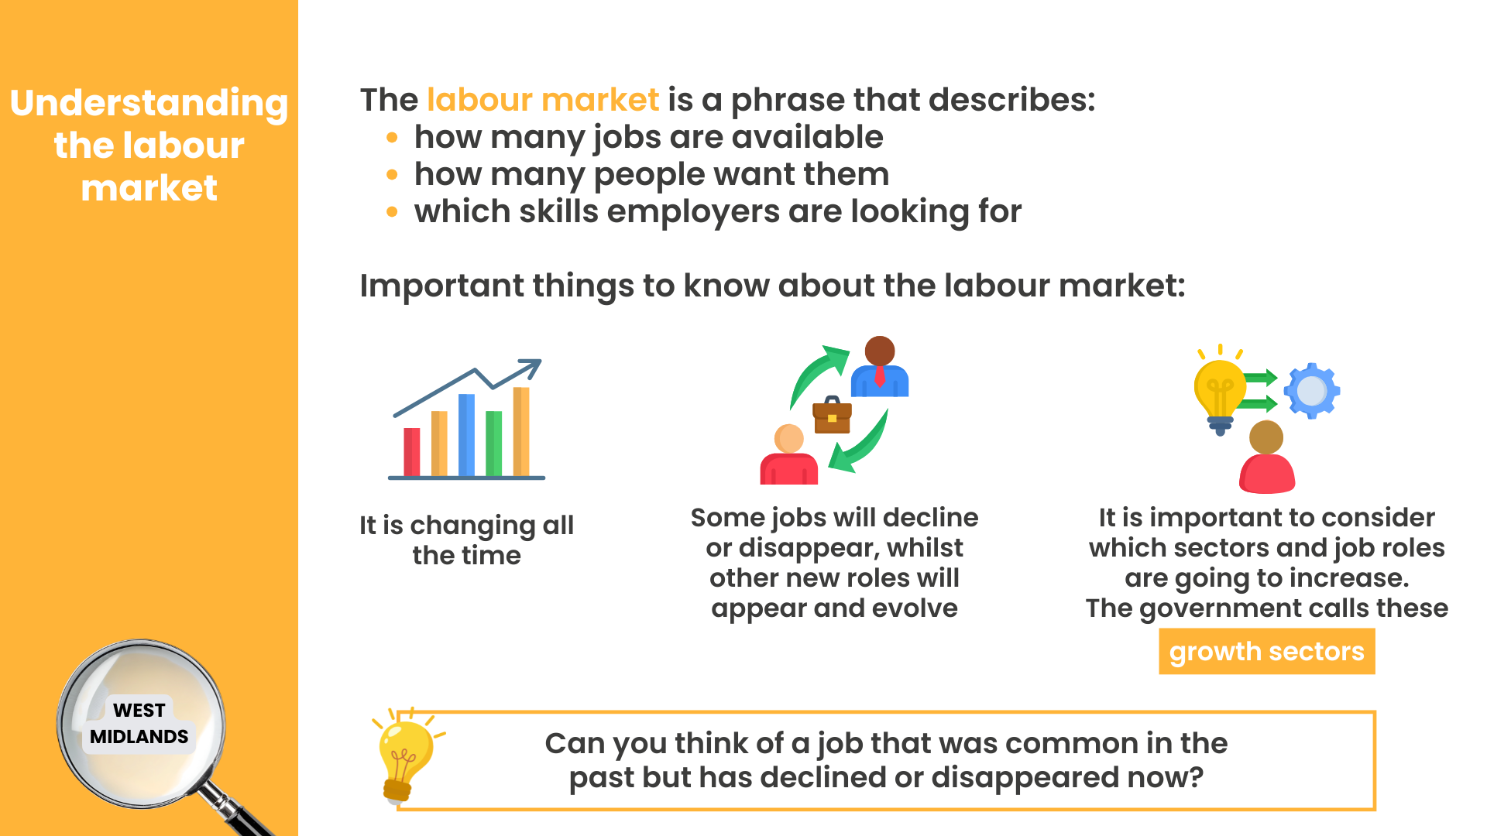
Notes:
The labour market is a phrase that describes how many jobs are available, how many people want them and which skills employers are looking for.
It’s important to know that the labour market changes all the time. Some jobs will decline or disappear, whilst other new roles will appear and evolve. When we’re thinking about careers and future options, we should also consider which sectors and job roles are going to increase. The government calls these growth sectors.
Optional audience interaction:
Can you think of a job that was common in the past but has declined or disappeared now?
Example answers:
Video rental shop assistant - shops like Blockbuster employed staff to manage physical tapes and DVDs – now we have streaming platforms and automated digital libraries.
Typist / word‑processing operator - offices once relied on dedicated staff to type letters, reports and forms for colleagues and then to post or fax them. This would’ve been the case in our school / college, but now everyone has personal computers and office software documents are sent via email.
Directory enquiries operator - people phoned a number to ask for someone’s telephone number, but now we have online search engines and digital contact directories.
Paste‑up artist (newspaper and magazine layout) - before digital publishing, staff physically cut and arranged content on boards but now it is digital.
Traditional travel agent (walk‑in model) - booking holidays with in‑person agents haw decreased with online booking platforms and comparison sites.

Slide 3
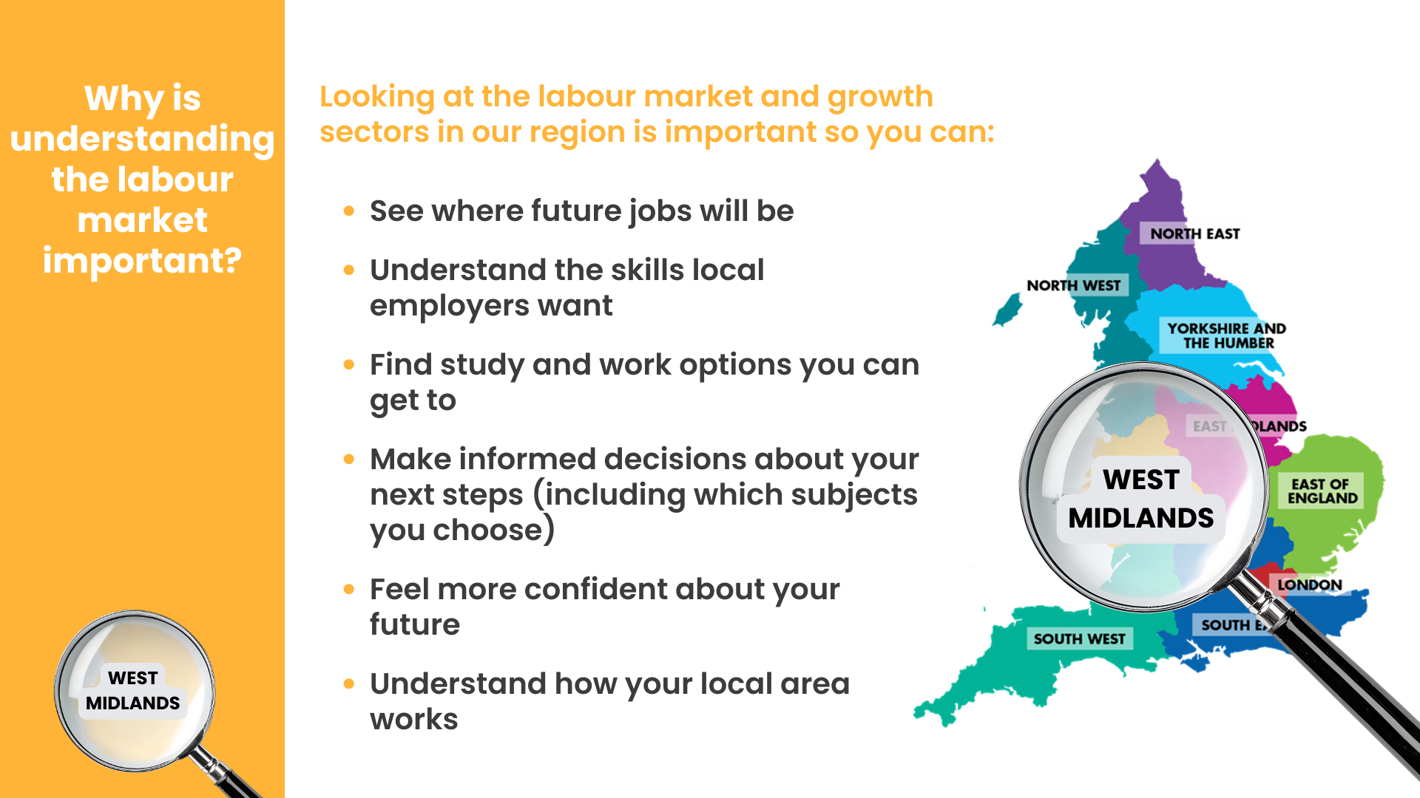
Notes:
Understanding the labour market and growth sectors is important for lots of reasons and it’s something you may not have thought about before. But if you’re starting to think about jobs you want to do in the future, it’s a really good idea to think about which jobs are available and if there will be opportunities in the area you live or want to live.
On the screen you can see some of the reasons why it’s important to understand the labour market:
See where future jobs will be – this is fundamental to helping you consider what your options are.
Understand the skills local employers want – if you know which jobs are going to be available, you can make sure you work on developing relevant skills.
Find study and work options you can get to – if you want to stay living where you are now, understanding what employers and jobs there are that you could actually travel to is really important.
Make informed decisions about your next steps (including which subjects you choose) – Speaker note: this will depend on which year group you are delivering to and when during the academic year – for example if it’s to year 9, they might have already chosen their GCSE options – if you know there are going to be lots of jobs in a particular area that you would like to do, it may be that you consider this when you are considering your next steps in education.
Feel more confident about your future - if you don’t know what you want to do, understanding what jobs are going to be out there can give you some inspiration and confidence, as well as help you know what you could do to work towards them.
Understand how your local area works – knowing what your local area is like and what employers and roles there are and might be is really important.

Slide 4
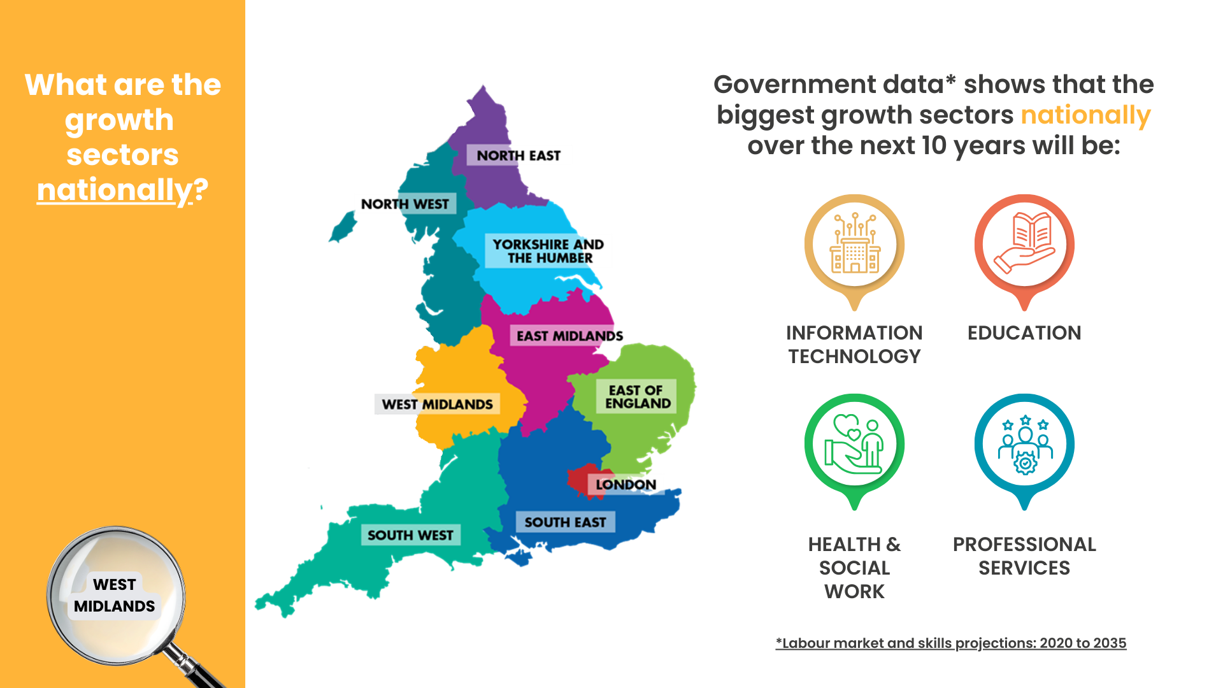
Notes:
The government looks at the labour market, and which areas are ‘growth sectors’, because they need a clear picture of what kinds of jobs the country will need in the future and what skills people will need to do them.
A study called ‘Labour market and skills projections: 2020-2035’ shows which sectors are likely to expand. This helps the government understand where future workers will be needed and adjust funding, apprenticeships and qualifications so young people can train for those roles.
They have found that nationally the biggest growth sectors will be Information Technology, Education, Health & Social Work and Professional Services (this includes roles in the legal sector, finance and accounting, business and management consultation, marketing, HR and many more).

Slide 5
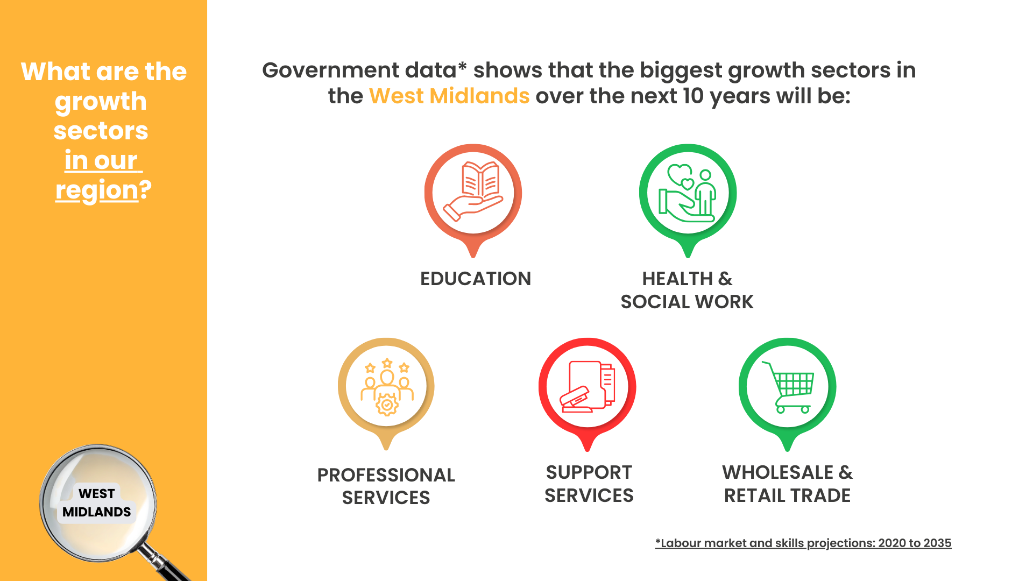
Notes:
It is also important to look locally, as we discussed earlier. Different regions grow in different ways. Projections help local leaders understand which jobs are coming to their area so they can shape local training, colleges and employer partnerships. The government study publishes regional and local breakdowns for this reason.
The labour market study showed that in the West Midlands, the biggest growth sectors will be Education, Health & Social Work, Professional Services (this includes roles in the legal sector, finance and accounting, business and management consultation, marketing, HR and many more) Support Services (which includes roles in Health & Safety, Security, Transport, Logistics, Facilities, Administrative & Operational Support and many more) and Wholesale & Retail Trade (which includes a huge range of roles linked to moving and supplying goods, selling goods and supporting the whole operation of wholesale and retail).
This doesn’t mean there aren’t lots of roles in other areas too, but it is really worth looking into growth sectors carefully and thinking about which roles might interest you – you will probably be really surprised at the wide range of interesting roles you may not have considered or even heard of!

Slide 6
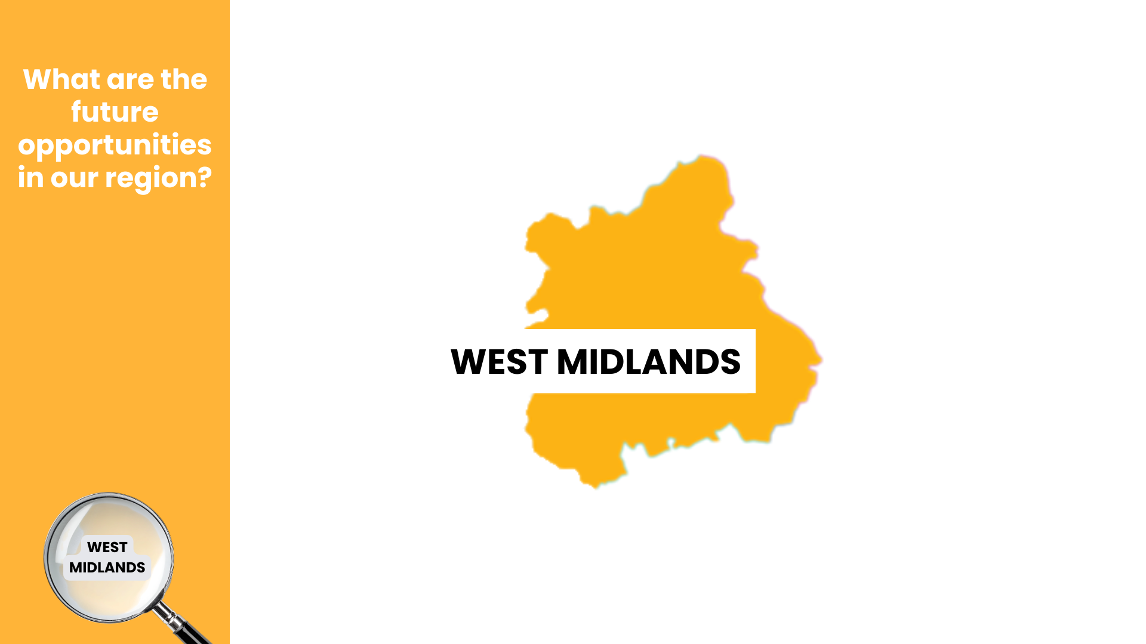

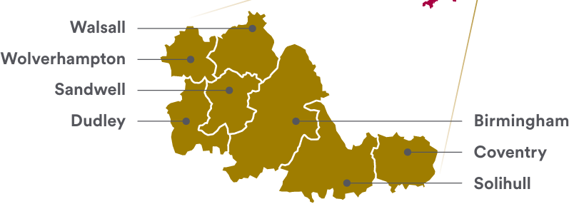
Notes:
The West Midlands is a big region, so it is also a good idea to look more closely at our local area and the growth sectors.
The West Midlands region includes the areas where we live including, Birmingham, Solihull, Coventry, Sandwell, Dudley, Walsall and Wolverhampton,.
Different regions grow in different ways. For our region - the West Midlands, The West Midlands Combined Authority has also published a regional growth plan to grow investment, skills and jobs for the future.

Slide 7








The West Midlands has an economic plan to grow investment, skills and jobs in these sectors:
Green Technology and Clean Energy
Advanced Manufacturing and Engineering
Health, Life Sciences and Care
Digital, Creative and AI
Professional and Financial Services
Notes:
For the West Midlands there are FIVE GROWTH SECTORS that are key to the West Midlands Growth Strategy and driving the local economy. These are:
Green Technology and Clean Energy
Advanced Manufacturing and Engineering
Health, Life Sciences and Care
Digital, Creative and AI
Professional and Financial Services
- Speaker note: At this point, you could share one or more of the sector films in the next slides. You can find all the films here – copy and paste into your browser: https://resources.careersandenterprise.co.uk/resources/growth-sector-videos - being added The Careers & Enterprise Company - Summer 2026
More information can be found here: West Midlands Growth Plan https://growth.wmca.org.uk/

Slide 8

Watch it here: https://vimeo.com/1183750369?fl=pl&fe=s
Notes:
(SPEAKER: To play film link, copy & paste link to your browser: https://vimeo.com/1183750369?fl=pl&fe=sh
Film length: 2min 38 sec)
Green Technology and Clean Energy is one of FIVE GROWTH SECTORS that are key to the West Midlands Growth Strategy and driving the local economy.

Slide 9

Notes:
(SPEAKER: To play film link- copy & paste to your browser: https://vimeo.com/1210169061?fl=pl&fe=sh
Film length: 3 min 33 sec)
Advanced Manufacturing and Engineering is one of FIVE GROWTH SECTORS that are key to the West Midlands Growth Strategy and driving the local economy.

Slide 10
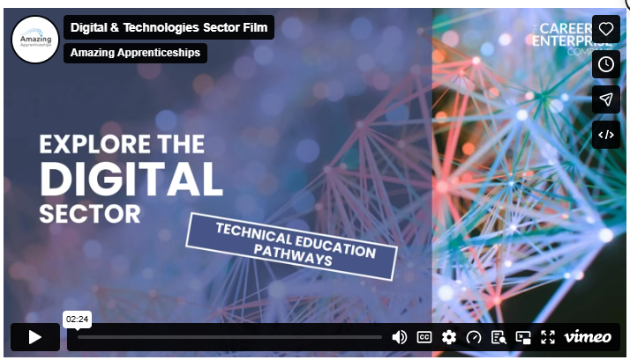
Notes:
(SPEAKER: To play film link- copy & paste to your browser: https://vimeo.com/1182594437?fl=pl&fe=sh
Film length = 2 min 24 seconds)
Digital, Creative and AI is one of FIVE GROWTH SECTORS that are key to the West Midlands Growth Strategy and driving the local economy.

Slide 11

Notes:
(SPEAKER: To play film link- copy & paste to your browser: https://vimeo.com/1215845564?fl=pl&fe=sh
Film length: 2 min 24 sec)
Professional Services is one of FIVE GROWTH SECTORS that are key to the West Midlands Growth Strategy and driving the local economy.

Slide 12
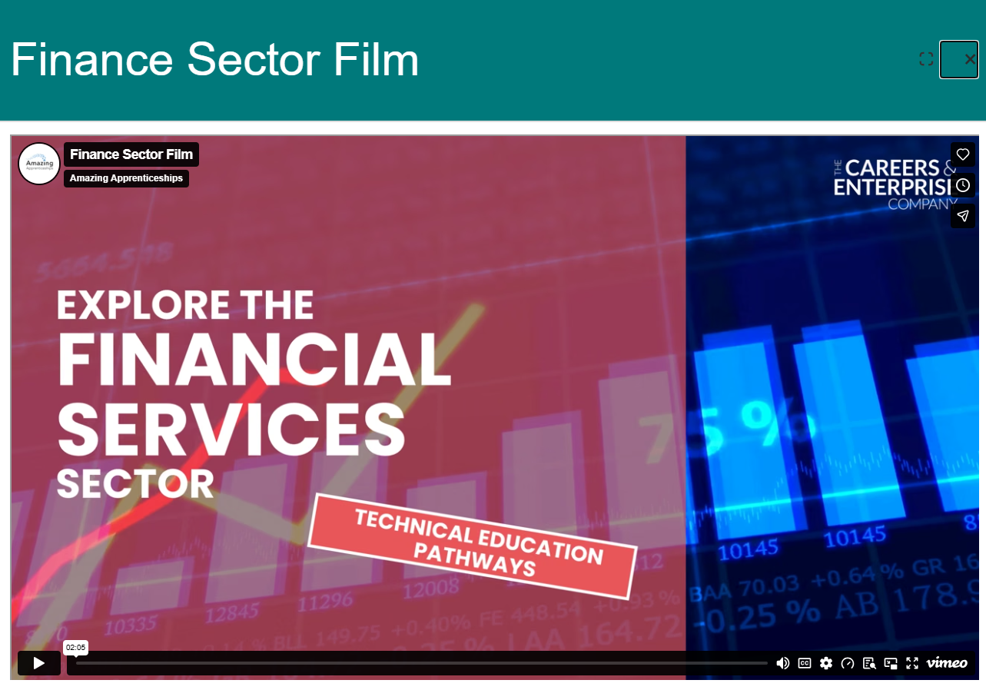
Notes:
(SPEAKER: To play film link- copy & paste to your browser: https://vimeo.com/1169111029?fl=pl&fe=sh
Fim length: 2 min 04 sec)
Financial Services is also one of the GROWTH SECTORS that are key to the West Midlands Growth Strategy and driving the local economy.

Slide 13
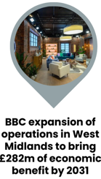
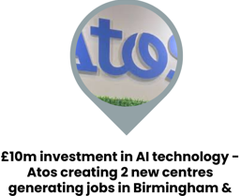



Solihull & Coventry
£3 billion investment in a new Sports Quarter in Birmingham, a 62,000-capacity stadium, leisure and residential spaces creating 14,000 jobs
22,000 jobs created through Birmingham’s Knowledge Quarter aimed at advanced digital tech and health tech
Notes:
Speaker note: please see the first slide for instructions on how to add relevant information to this slide before presenting.
When a region gets major new developments like new business parks, transport links, science hubs, logistics centres, hospitals, green‑energy sites or digital campuses, it can bring in new employers, new investment and new types of work. For you, this could mean more pathways opening-up close to home.
You can see some new developments in our region here, that are going to bring in new businesses, new industries and new opportunities. That means more jobs, more apprenticeships and more career paths opening-up right here on our doorstep.
The roles you’ll step into in the next few years might not even exist yet, but the skills you build now will prepare you for them.
These developments aren’t just about buildings or companies; they’re about your future and the chance to shape the place you live. Other developments include the GreenPower Park, Coventry.

Slide 14

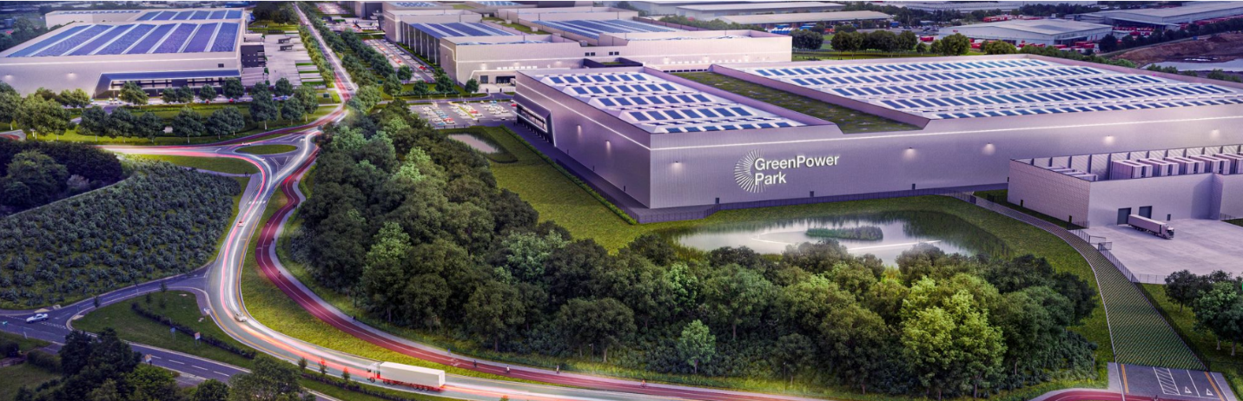
GreenPower Park, Coventry a £2.5 billion centre of excellence for battery technology, advanced manufacturing and clean energy innovation.
Notes:
Speaker note: please see the first slide for instructions on how to add relevant information to this slide before presenting.
When a region gets major new developments like new business parks, transport links, science hubs, logistics centres, hospitals, green‑energy sites or digital campuses, it can bring in new employers, new investment and new types of work. For you, this could mean more pathways opening-up close to home.
You can see some new developments in our region here, that are going to bring in new businesses, new industries and new opportunities. That means more jobs, more apprenticeships and more career paths opening-up right here on our doorstep.
The roles you’ll step into in the next few years might not even exist yet, but the skills you build now will prepare you for them.
These developments aren’t just about buildings or companies; they’re about your future and the chance to shape the place you live. Other developments include the GreenPower Park, Coventry.

Slide 15
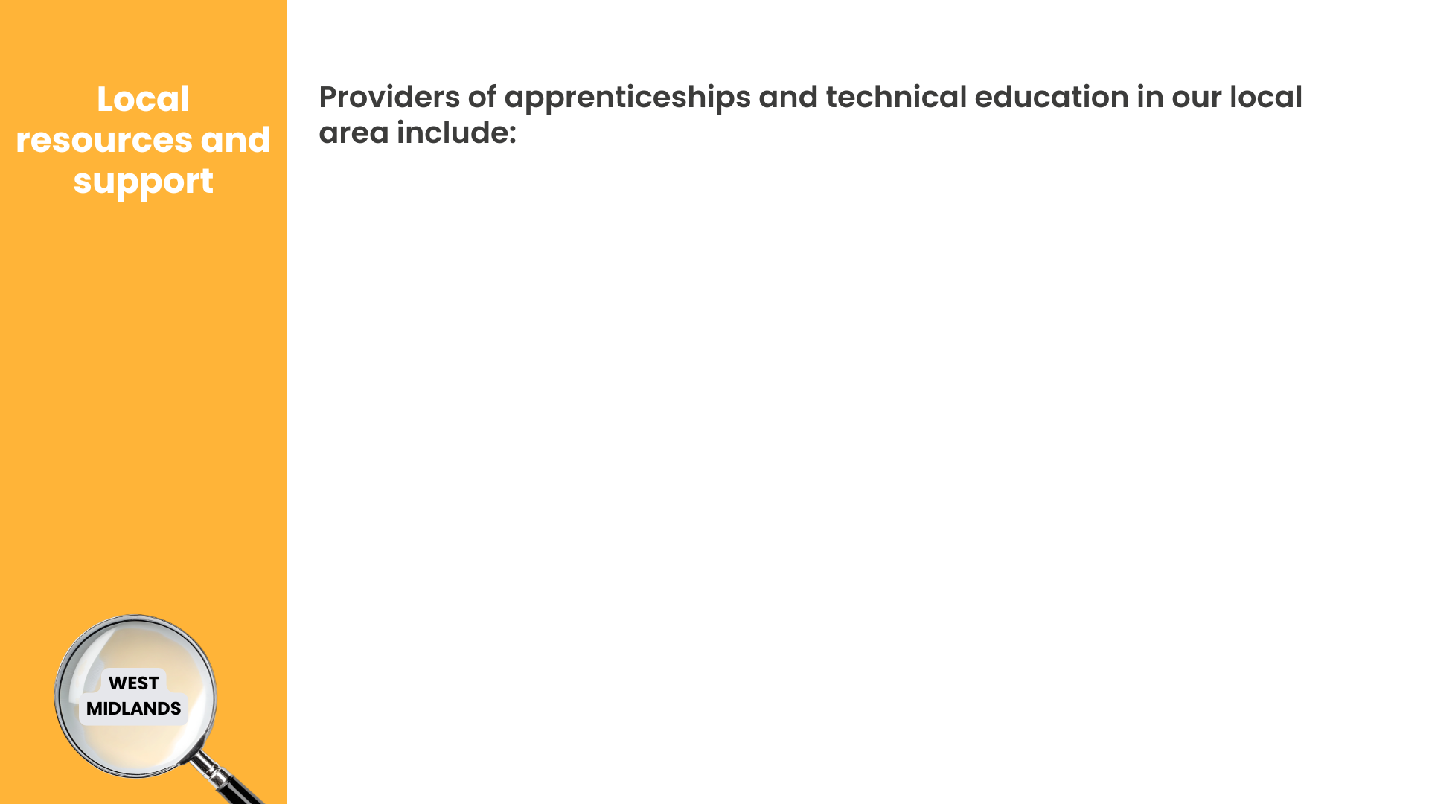



Aston University Engineering Academy Sixth Form
(Aston, Birmingham)
Jewellery, Midwifery, Nursing, Marketing & Social Media, Mechanical, Electronic or Civil Engineering & more
Access Creative College
(Digbeth, Birmingham)
Music Production, Media & Design, Games Development
Creative Alliance
(Digbeth, Birmingham):
Creative, Digital & Marketing
Notes:
A brilliant way into roles in the growth sectors we’ve discussed today is technical education – for example T Levels, apprenticeships, Higher Technical Qualifications (HTQs). On the screen now you can see some of the providers of apprenticeships and technical education in our area, and where you can find out more about careers locally.
Speaker note: at this point, you may wish to show any websites about careers in your local area.

Slide 16



In Comm Training
(Walsall)
Engineering, Manufacturing, Health & Safety
Juniper Training
(Wolverhampton, Walsall, Dudley, Sandwell, Coventry)
Business, Customer Service, Construction, Logistics, Education, Sport
Kaplan
(Birmingham)
Accountancy, Banking, Finance, Taxation, AI, Data, Technology
Notes:
A brilliant way into roles in the growth sectors we’ve discussed today is technical education – for example T Levels, apprenticeships, Higher Technical Qualifications (HTQs). On the screen now you can see some of the providers of apprenticeships and technical education in our area, and where you can find out more about careers locally.
Speaker note: at this point, you may wish to show any websites about careers in your local area.

Slide 17



Make UK
(Aston, Birmingham)
Advanced Manufacturing
Nova Training
(Walsall, Wolverhampton, Sandwell, Dudley, Birmingham)
ESports, Retail, Business, Customer Service, Motor Vehicle, Transport & Warehouse, Early Years
The Development Manager
(Digbeth, Birmingham)
AI & Automation, Cyber Security, Data, Tech & Networks, Software & Marketing
Some of the above may also be available at FE Colleges in your local area. Apprenticeships may also be advertised by employers directly.
Notes:
A brilliant way into roles in the growth sectors we’ve discussed today is technical education – for example T Levels, apprenticeships, Higher Technical Qualifications (HTQs). On the screen now you can see some of the providers of apprenticeships and technical education in our area, and where you can find out more about careers locally.
Speaker note: at this point, you may wish to show any websites about careers in your local area.

Slide 18
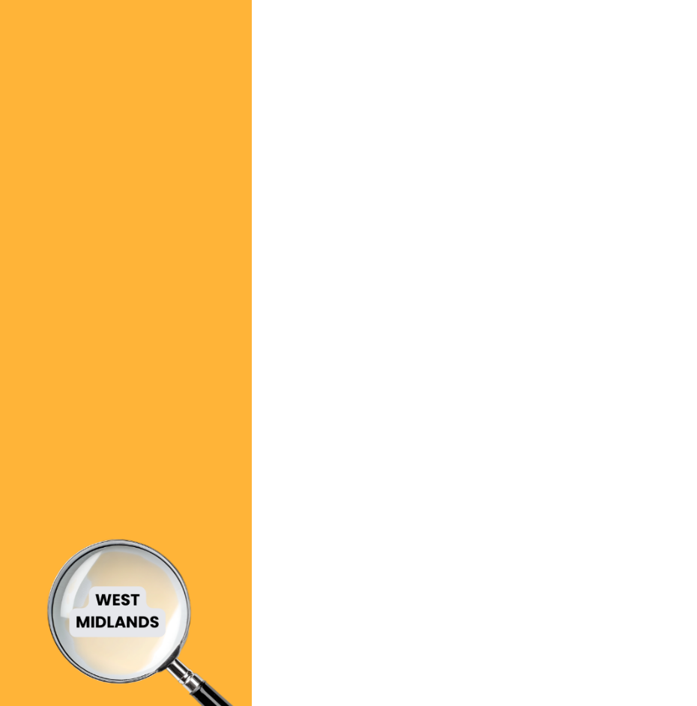
West Midlands Growth Plan
WMCA - The Post-Exam Survival Guide
Birmingham Careers Service
Residents | Solihull Metropolitan Borough Council
Sandwell Careers Service
Connexions Dudley
Wolves Workbox - Wolverhampton Connexions
Walsall Works
Coventry Careers Advice Shop
Coventry Opportunities – Slenky App
Coventry and Warwickshire Chamber Training & Advice
The King’s Trust
National Careers Service
Find an Apprenticeship
Links
&
Useful Websites

